Slide 1





CU Data Week
Title:
Figures in R
By:
Wyatt Tarter, MS
Date:
February 2nd, 2023
Center for Innovative Design and Analysis
CIDAstats

Slide 2

AGENDA
Data Visualization overview
Base R vs GGplot vs sjPlot
Examples!

Slide 3
Visualization Types
Associations
Scatter plots
Line plots
Alluvial plots
Heat maps
Distributions
Histograms
Density plots
Violin plots
Descriptive
Bar plots

Slide 4
Basics of R Visualization
Data
Types
Matrix
Data frame - preferable
Tibble – also fine but some issues at times
Variables
Categorical
Continuous
Formats
Wide – single row per subject, column for each variable
Long – multiple rows per subject, condensed columns
Functions
Input syntax
Required vs optional
Output

Slide 5
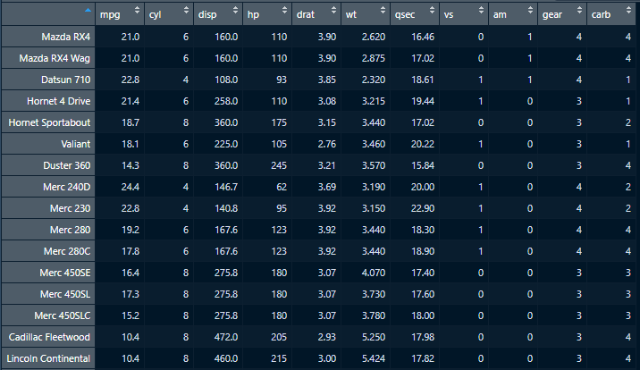
Mtcars Data Set

Slide 6
Base R
plot(x,y,…)
Ex.
points()
lines()
hist()
Pro(s):
Simple to understand and use
Con(s):
Harder to augment
Clunky code
Default, bland look

Slide 7
GGplot2
ggplot(data, aes(x,y))
Ex.
geom_point()
geom_line()
geom_hist()
Pro(s)
Endlessly flexible
Generalized format for all graph types
Easy to create complex figures
Highly customizable themes
Con(s)
Learning curve
Syntax – google!

Slide 8
sjPlot
plot_
Ex.
plot_model()
plot_scatter()
plot_frq()
Pro(s)
Fairly flexible
Similar format for graph types
Quick to make some complicated figures
Less syntax and learning curve
Con(s)
Not as modifiable
Less widely used

Slide 9
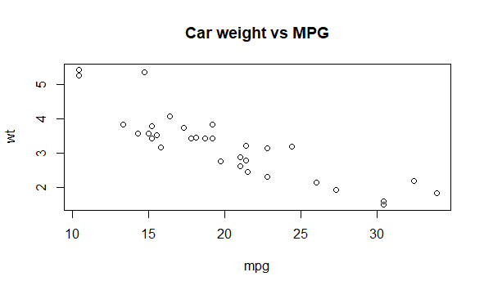
Base R Example
Code in R:
plot(x=mtcars$mpg,
y=mtcars$wt,
ylab="wt",
xlab="mpg",
main="Car weight vs MPG")

Slide 10
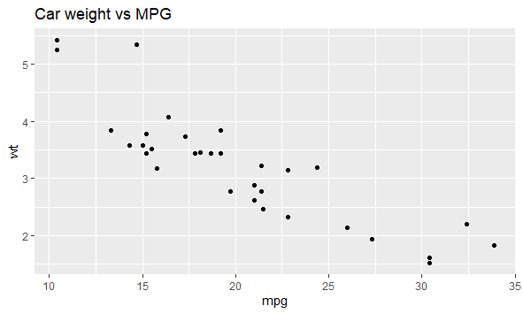
GGPlot Example
Code in R:
ggplot(mtcars, aes(x=mpg, y=wt)+
geom_point()+
labs(title= "Car weight vs MPG")

Slide 11
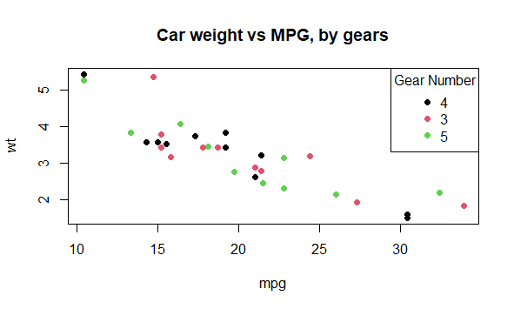
Base R Example
plot(x=mtcars$mpg,
y=mtcars$wt,
ylab="wt",
xlab="mpg",
col=1:length(unique(mtcars$gear)),
main="Car weight vs MPG, by gears",
pch=19)
legend("topright",
legend=unique(mtcars$gear),
col=1:length(unique(mtcars$gear)),
pch=19,
title="Gear Number")

Slide 12
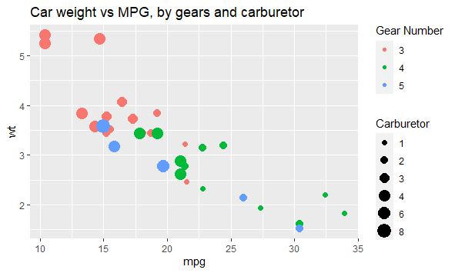
GGPlot Example
ggplot(mtcars,
aes(x=mpg,y=wt,col=factor(gear)),size=factor(carb))+
geom_point(aes(size=factor(carb)))+
labs(title="Car weight vs MPG, by gears and carburetor",
col="Gear Number",
size="Carburetor")

Slide 13
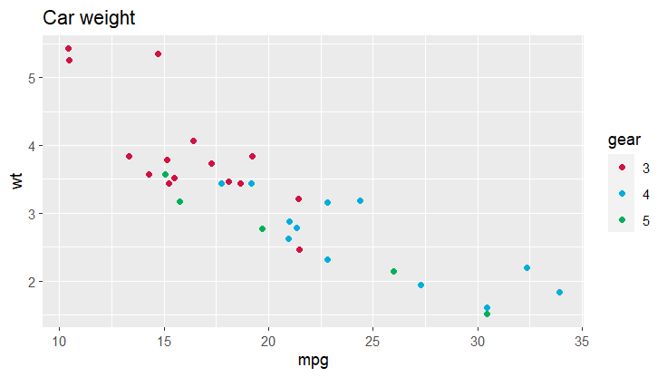
sjPlot Example
plot_scatter(mtcars,
x = mpg,
y = wt,
grp = gear,
title = "Car weight")

Slide 14
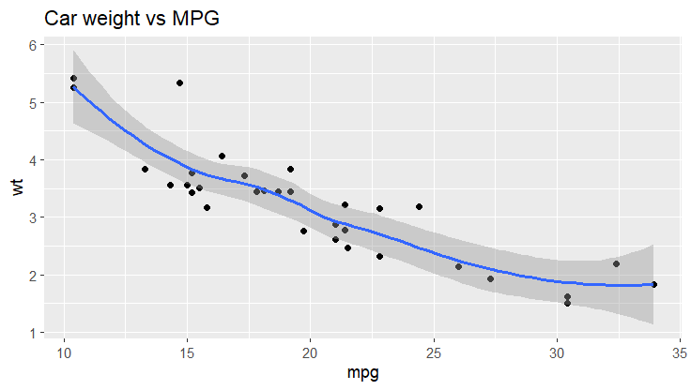
GGPlot Example
ggplot(mtcars,
aes(x=mpg,y=wt))+
geom_point()+
labs(title= "Car weight vs MPG") + geom_smooth()

Slide 15
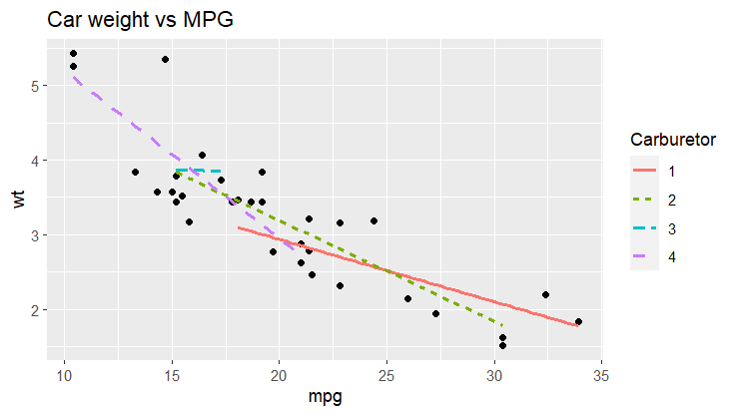
GGPlot Example
ggplot(mtcars,
aes(x=mpg,y=wt,
group = factor(carb)))+ geom_point()+
labs(title= "Car weight vs MPG") +
geom_smooth(method = "lm", se = F,
aes(col = factor(carb),
linetype = factor(carb))) + labs(col="Carburetor",
linetype = "Carburetor")

Slide 16
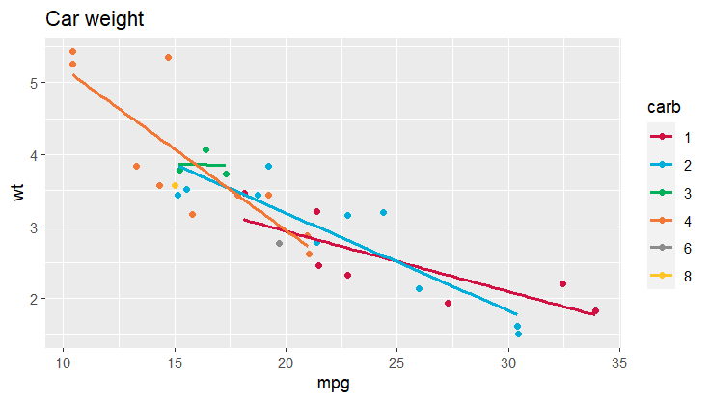
sjPlot Example
plot_scatter(mtcars,
x = mpg,
y = wt,
grp = carb,
title = "Car weight", fit.grps = "lm")

Slide 17
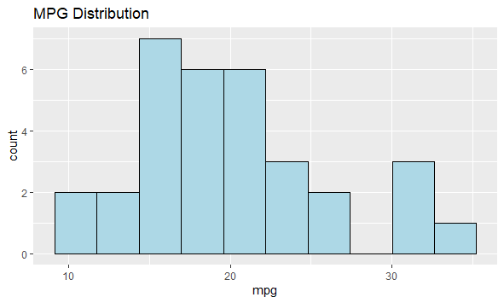
Histograms
ggplot(mtcars,aes(x=mpg))+
geom_histogram(bins=10,
fill="light blue",
col="black")+
labs(title="MPG Distribution")

Slide 18
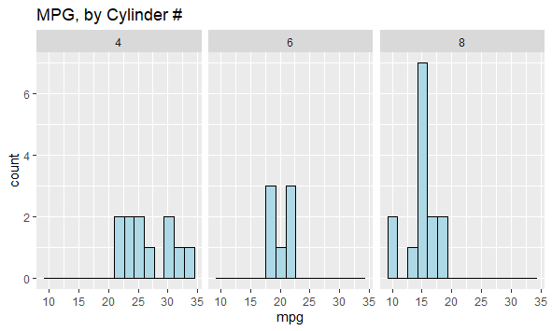
Histograms
ggplot(mtcars,aes(x=mpg))+
geom_histogram(bins = 15,
col="black",
fill="light blue")+
facet_grid(.~cyl)+
labs(title="MPG, by Cylinder #")

Slide 19
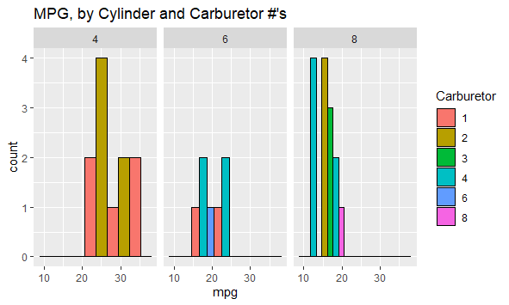
Histograms
ggplot(mtcars,aes(x=mpg,fill=factor(carb)))+
geom_histogram(bins = 5,
col="black",
position = "dodge")+
facet_grid(.~cyl)+
labs(fill="Carburetor",
title="MPG, by Cylinder and Carburetor #'s")

Slide 20
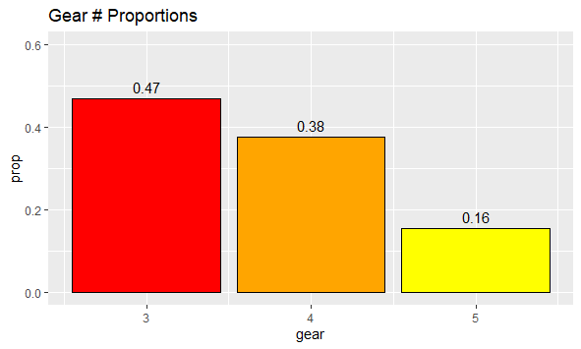
Bar Plot
ggplot(mtcars,aes(x=gear))+
geom_bar(aes(y=..prop..),
fill=c("red","orange","yellow"),
col="black",
stat="count")+
geom_text(aes(label=round(..prop..,2),y=..prop..),
stat="count",
vjust=-0.5)+
scale_y_continuous(limits = c(0,0.6))+
labs(title="Gear # Proportions")

Slide 21
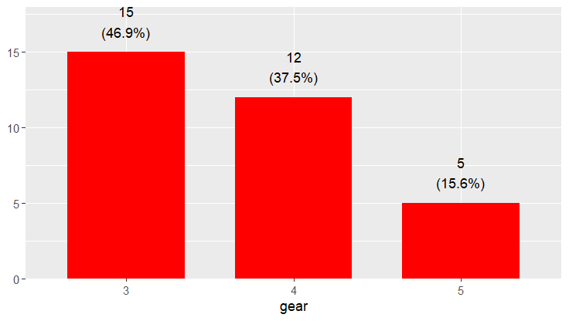
sjPlot Bar Plot
plot_frq(mtcars, gear, geom.colors = "red")

Slide 22
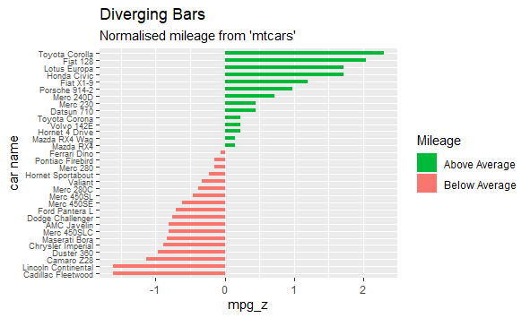
Bar Plot
mtcars%>%
mutate(`car name`=rownames(mtcars),
mpg_z = round(scale(mpg), 2),
mpg_type = ifelse(mpg_z < 0, "below", "above"),
`car name` = factor(`car name`,
levels = mtcars$`car name`))%>%
arrange(mpg_z)%>%
ggplot(., aes(x=`car name`, y=mpg_z, label=mpg_z)) +
geom_bar(stat='identity', aes(fill=mpg_type), width=.5) +
scale_fill_manual(name="Mileage",
labels = c("Above Average", "Below Average"),
values = c("above"="#00ba38", "below"="#f8766d")) +
labs(subtitle="Normalised mileage from 'mtcars'",
title= "Diverging Bars") +
theme(axis.text.y=element_text(size=7))+
coord_flip()

Slide 23
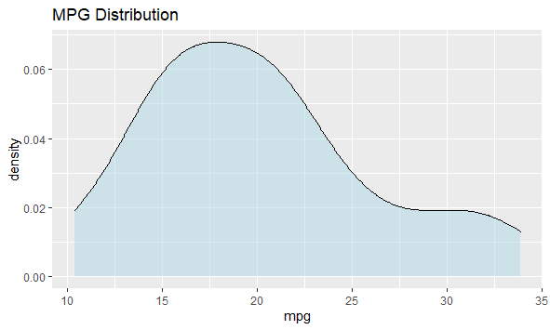
Density Plots
ggplot(mtcars,aes(x=mpg))+
geom_density(fill="light blue",
alpha=0.5)+
labs(title="MPG Distribution")

Slide 24
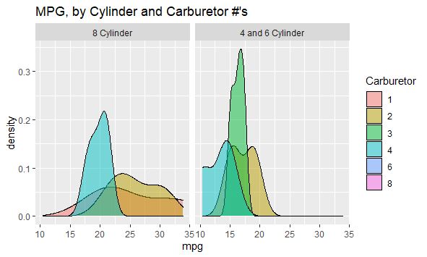
Density Plots
ggplot(mtcars,aes(x=mpg,fill=factor(carb)))+
geom_density(alpha=0.5)+
facet_grid(.~cyl>6,
labeller=as_labeller(c(`TRUE`="4 and 6 Cylinder",
`FALSE`="8 Cylinder")))+
labs(fill="Carburetor",
title = "MPG, by Cylinder and Carburetor #'s")

Slide 25
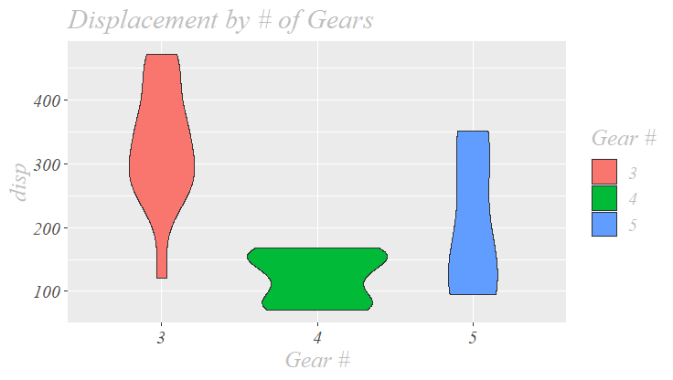
Violin Plot
ggplot(mtcars, aes(y=disp,x=factor(gear),
fill=factor(gear)))+
geom_violin()+
labs(fill="Gear #",
title="Displacement by # of Gears")+
xlab(label="Gear #") +
theme(text = element_text(family = 'serif', size = 15,
color = "grey",
face = "italic"))

Slide 26
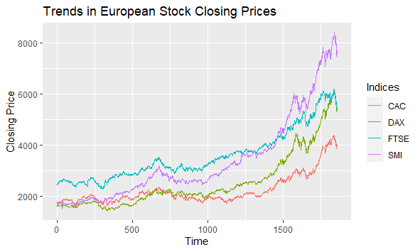
Line Plot
ggplot(EuStockMarketsLong,
aes(x=Time, y=`Closing Price`, col=Indices))+
geom_line()+
labs(title="Trends in European Stock Closing Prices")

Slide 27
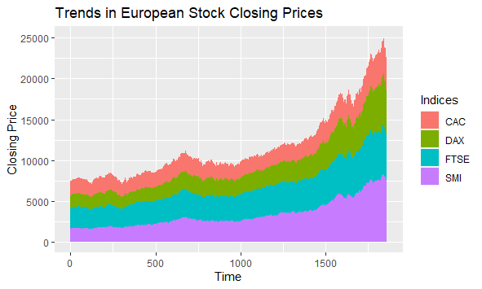
Area Plot
ggplot(EuStockMarketsLong,
aes(x=Time, y=`Closing Price`, fill=Indices))+
geom_area()+
labs(title="Trends in European Stock Closing Prices")

Slide 28
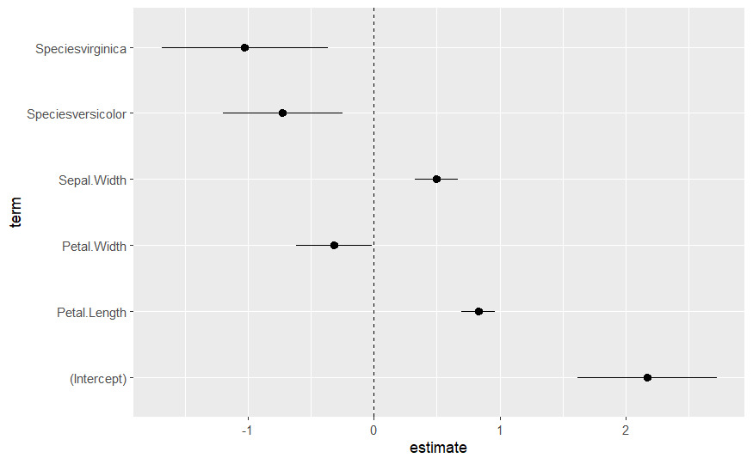
Forest Plot
data("iris")
model<-lm(Sepal.Length ~ Sepal.Width + Petal.Length + Petal.Width + Species,
data = iris)
model %>%
broom::tidy(conf.int = T) %>%
ggplot(., aes(x=term, y=estimate,
ymin=conf.low,
ymax=conf.high)) +
geom_pointrange() +
geom_hline(yintercept = 0,
linetype = "dashed") +
coord_flip()

Slide 29
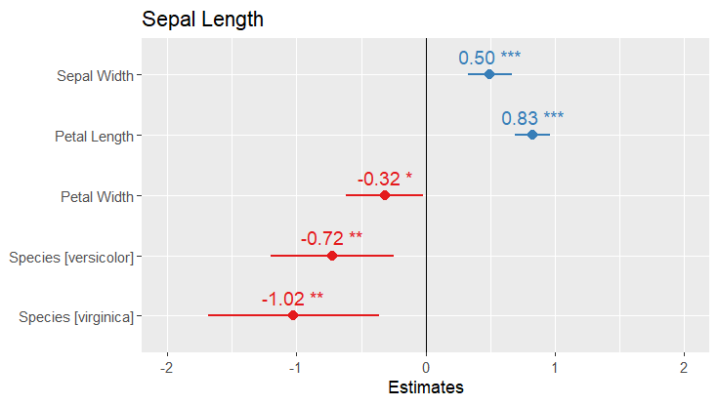
sjPlot Forest Plot
data("iris")
model<-lm(Sepal.Length ~ Sepal.Width + Petal.Length + Petal.Width + Species,
data = iris)
plot_model(model,
vline.color = "black",
show.values = T,
value.offset = 0.3)

Slide 30
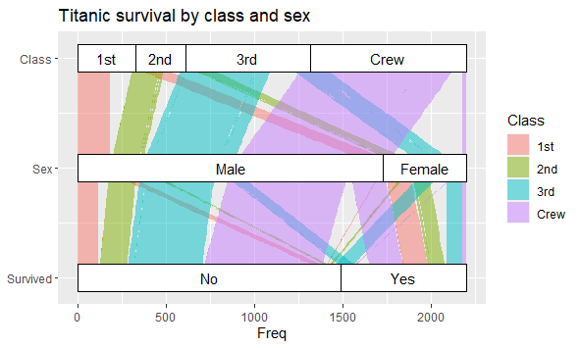
Alluvial Plot (ggalluvial)
ggplot(Titanic,aes(y=Freq,axis1=Survived,axis2=Sex,axis3=Class)) +
geom_alluvium(aes(fill = Class),
width = 0, knot.pos = 0, reverse = FALSE) +
geom_stratum(width = 1/4, reverse = FALSE) +
geom_text(stat = "stratum", aes(label = after_stat(stratum)),
reverse = FALSE) +
scale_x_continuous(breaks = 1:3, labels = c("Survived", "Sex", "Class")) +
coord_flip() +
ggtitle("Titanic survival by class and sex")

Slide 31
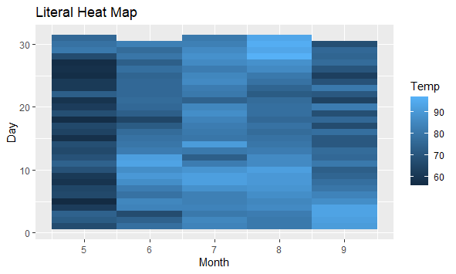
Heat Map
ggplot(airquality,
aes(x=Month,y=Day,fill=Temp))+
geom_tile()+
labs(title="Literal Heat Map")

Slide 32
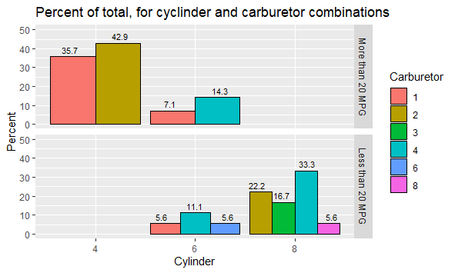
Bar Plots Advanced
ggplot(.,
aes(y=Percent,
x=factor(cyl),
fill=factor(carb)))+
geom_col(position = "dodge",
col="black")+
geom_text(aes(label=round(Percent,1)),
size=3,
vjust=-0.5,
position = position_dodge(width = 1))+
scale_y_continuous(limits = c(0,50))

Slide 33
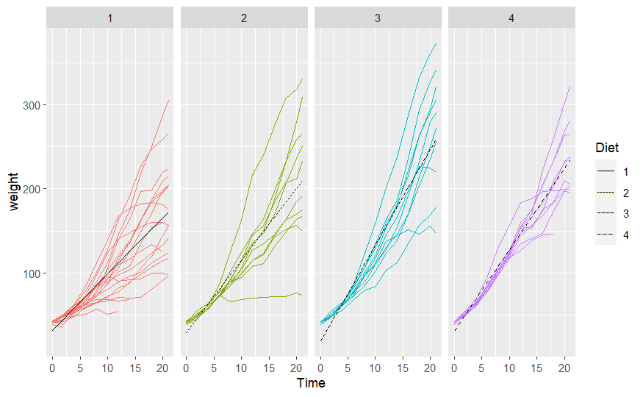
Linear Model w/ Interaction Term Plotted
model<-lme4::lmer(weight~Time*Diet + (1|Chick),
data=ChickWeight)
model_effects <- effect("Time*Diet",
model) %>%
as.data.frame()
ggplot(ChickWeight,
aes(y=weight,x=Time,col=Diet,group=Chick))+
geom_line() +
geom_line(data=model_effects, aes(group=Diet,y=fit,x=Time,linetype=Diet),col="black") +
facet_grid(.~Diet)

Slide 34
Output
Copy paste directly from Rstudio
Not advised due to issues with resolution, sizing, and reproducibility,
but very fast!
Output into html/word doc/pdf using Rmarkdown or Quarto (or into a powerpoint slide!)
Great reproducibility
May have to rerun entire rmarkdowns to redo a single image
Use ggsave() function
Will save to jpeg, pdf, or png
Manually specify size (inches, cm, mm, px)
Can greatly enhance resolution
Open and edit from within Rstudio
Export button in Plots pane
Save as Image/PDF
Copy to clipboard and manually change sizing
Similar issue to copying directly

Slide 35

Thank you!
Follow us:
Learn about our services:
Center for Innovative Design and Analysis
cida.ucdenver.edu
CIDAstats

